Slide 1
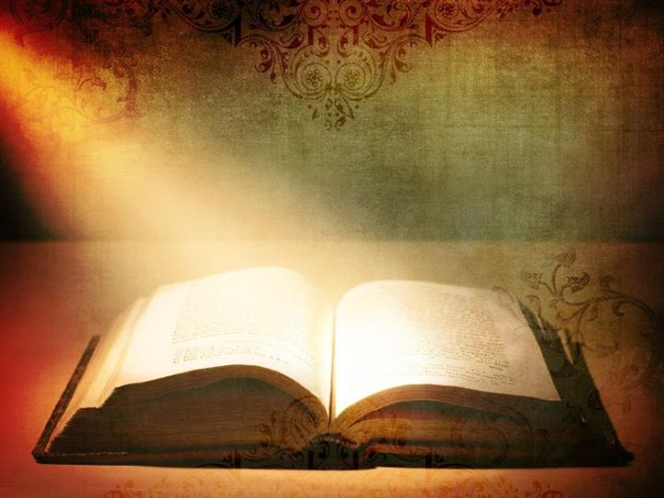
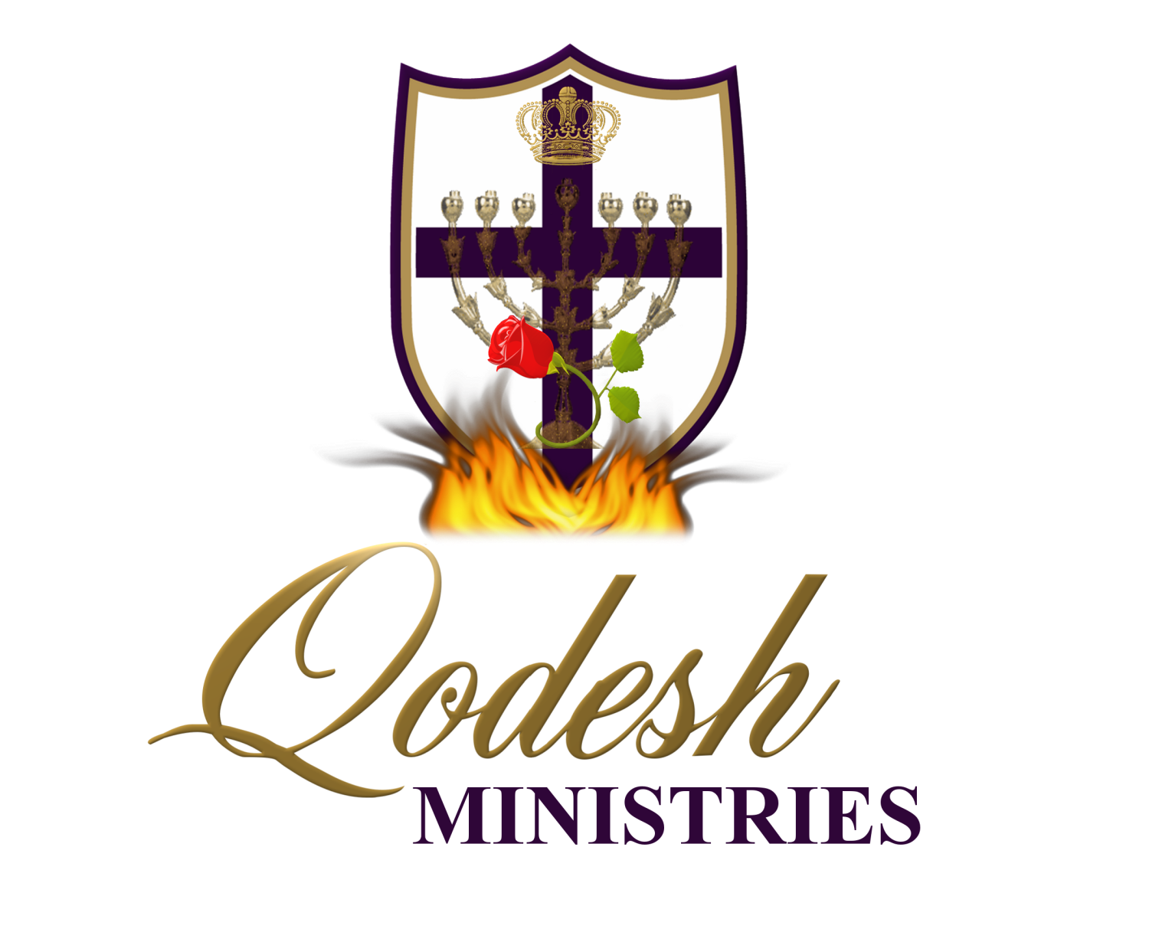

Slide 2
RECOGNITION
THE MESSIANIC PROPHECY BIBLE PROJECT
http://www.messianicbible.com
HEAR O ISRAEL
www.hearoisrael.org
SHEEPFOLD GLEANINGS WRITTEN BY JULIE PARKER
www.sheepfoldgleanings.com
MESSIANIC ISRAEL ALLIANCE
http://www.messianicisrael.com
AZAMRA TORAH FOR OUR TIME – RABBI AVRAHAM GREENBAUM
http://www.azamra.org

Slide 3
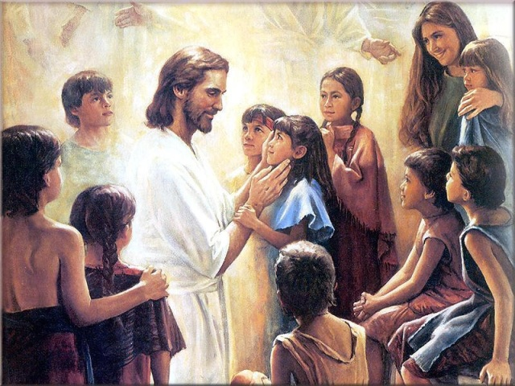
V'ZOT HABERACHAH
“This is the blessing”
TORAH: Deuteronomy 33:1-34:12
HAFTORAH: Joshua 1:1-18
B’RIT CHADASHAH: 1 Thessalonians 5:1-11
All references: The Scripture 1998+ unless otherwise noted

Slide 4
BLESSING
And this is the blessing with which Mosheh the man of Elohim blessed the children of Yisra’ĕl before his death. (Deuteronomy 33:1)
Blessings come forth through the channel ofיהוה 's Law. It is useless, for instance, to wish for someone's good health and prosperity if his favorite haunt is (and remains) the smoke-filled beer hall [that is, if he/she remains unrepentant, and make no effort to walk with the Master].
A true king wants to bless his subjects as they honor the laws of the kingdom. How much more does יהוה have a great, irrepressible desire to bless His people. So He told His people, again and again, that His blessings come through the vehicle of His righteous truth.

Slide 5
THE MAN OF ELOHIM
... Mosheh the man of Elohim .. (Deuteronomy 33:1)
This is the only place in the Torah where Moses is referred to as the “man of Elohim”. It is a common phrase that is found elsewhere in the Hebrew Scriptures as a title for prophets, 75 times in the Old Testament and 2 in the New Testament (1Titus 6:11, 2 Titus 3:17) :
And see, a man of Elohim went from Yehuḏah to Bĕyth Ěl by the word of יהוה, while Yaroḇʽam was standing by the altar to burn incense.
(1 Kings 13:1)
And she said to Ěliyahu, “What have I to do with you, O man of Elohim? Have you come to me to bring my crookedness to be remembered, and to kill my son?” (1 Kings 17:18)
There is only one Psalm that is attributed to Moses, the “man of Elohim”, i.e. A prophet: A Prayer of Moses the man of God. LORD, YOU have been our dwelling place and our refuge in all generations [says Moses]. (Psalms 90:1 AMP). How does יהוה see you?

Slide 6
ASSEMBLY
Mosheh commanded us a Torah, an inheritance of the assembly of Yaʽaqoḇ. (Deuteronomy 33:4)
The Torah is a possession of the “congregation”! Torah was not meant to be given to individuals as it is the assembly that keeps us accountable. Is this what the writer of Hebrews was thinking about?
And let us be concerned for one another in order to stir up love and good works, not forsaking the assembling of ourselves together, as is the habit of some, but encouraging, and so much more as you see the Day coming near. For if we sin purposely after we have received the knowledge of the truth, there no longer remains a slaughter offering for sins, but some fearsome anticipation of judgment, and a fierce fire which is about to consume the opponents. Anyone who has disregarded the Torah of Mosheh dies without compassion on the witness of two or three witnesses. How much worse punishment do you think shall he deserve who has trampled the Son of Elohim underfoot, counted the blood of the covenant by which he was set apart as common, and insulted the Spirit of favour? (Hebrews 10:24-29)

Slide 7
BLESSINGS
Deuteronomy 33 continues with Moses’ blessings over the individual tribes. Jacob had blessed each of his sons according to that son’s individual potential and destiny. Now we read of Moses as he blesses the descendents of Jacob’s sons by their respective tribes.
Each tribe is blessed according to its personality and its responsibilities. The translations of these blessings vary substantially as there are Hebrew words and phrases in these blessings that appear nowhere else in the Bible. It is one of the rare places in the Hebrew Scriptures where there are some differences between the oldest Hebrew manuscripts.
Jeffrey Tigay puts it like this: it is full of rare words, syntactic difficulties, grammatical inconsistencies and opaque allusions.

Slide 8
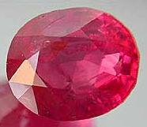
REUBEN (Ruby)
Jacob prophecy:
“Re’uḇĕn, you are my first-born, my power and the beginning of my strength, the excellency of exaltation and the excellency of power. “Boiling like water, you do not excel, because you went up to your father’s bed, then you defiled it – he went up to my couch. (Genesis 49:3-4)
Moses blessing:
“Let Re’uḇĕn live, and not die, and let his men be numbered.” (Deuteronomy 33:6)
Name meaning:
“see a son” Genesis 29:32
Birth stone meaning:
Odem, root leads to “daman” which means to submit (Hebrew Chaldean Lexicon by Davidson pg 152)

Slide 9
LIFE
Moses blessing seems pretty short and sweet, but what does it mean? Moses blesses the tribe of Reuben with “life”. There’s a bit of grace in this blessing as it was Reuben who took his father Jacob’s concubine and lay with her. Here is what Torah had to say about that:
‘And a man who lies with the wife of his father has uncovered the nakedness of his father, both of them shall certainly be put to death, their blood is upon them. (Leviticus 20:11)
The reason why he was pardoned for this offense could have been, was that Torah had not yet been given from Mt. Sinai. There are a few reasons for blessing Reuben with “life”. Reuben had already been given territory on the east side of the Jordan. Reubenites could therefore not survive as an official tribe outside of the Promised Land. Or, Jewish sages offer a military explanation. In return for the land on the east of the Jordan, the Reubenite men had promised to take the front line in the battles to conquer the Promised Land. Moses prays a blessing of “life” over them in light of this dangerous mission.

Slide 10
WALKING SUBMITTED
“Of Myself I am unable to do any matter. As I hear, I judge, and My judgment is righteous, because I do not seek My own desire, but the desire of the Father who sent Me. (John 5:30)
יהושע was totally submitted, He was and is the perfect forerunner for all mankind through His submission unto death.
For “He who wishes to love life and see good days, let him keep his tongue from evil, and his lips from speaking deceit, let him turn away from evil and do good, let him seek peace and pursue it. “Because the eyes of יהוה are on the righteous, and his ears are open to their prayers, but the face of יהוה is against those who do evil.” And who is the one doing evil to you, if you become imitators of the good? But even if you suffer for righteousness’ sake, you are blessed. “And do not fear their threats, neither be troubled.” (1 Peter 3:10-14)

Slide 11
LACK OF SUBMISSION
Where do fightings and strivings come from among you? Do they not come from your pleasures that battle in your members? You desire, and do not have. You murder, and are jealous, and are unable to obtain. You strive and fight, and you do not possess, because you do not ask. You ask and do not receive, because you ask evilly, in order to spend it on your pleasures. Adulterers and adulteresses! Do you not know that friendship with the world is enmity with Elohim?¹ Whoever therefore intends to be a friend of the world makes himself an enemy of Elohim. Or do you think that the Scripture speaks to no purpose? Does the Spirit which dwells in us intensely crave unto envy? But He gives greater favour. Because of this He says, “Elohim resists the proud, but gives favour to the humble.”
(James 4:1-6)

Slide 12
SUBMIT TO GOD
So then subject yourselves to Elohim. Resist the devil and he shall flee from you. Draw near to Elohim and He shall draw near to you. Cleanse hands, sinners. And cleanse the hearts, you double-minded! (James 4:7-8)
The humble receive grace from God. In Greek “the humble” it means the low lying one, to lie low, to lie under. If we are proud and arrogant, יהוה resists us! So we are entertaining Satan when we are proud.
Rabbi’s teach if we open a gate the size of needle through repentance and humbleness of spirit before יהוה, He will open the gate up to the size that a camel will go through .

Slide 13
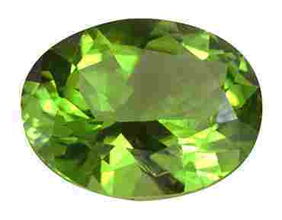
JUDAH (Turquoise)
Jacob Prophecy: “You, Yehuḏah, your brothers praise you; your hand is on the neck of your enemies; your father’s children bow down before you. “Yehuḏah is a lion’s cub; from the prey you have gone up, my son! He bowed down, he crouched like a lion. And like a lion, who does rouse him? “The sceptre shall not turn aside from Yehuḏah, nor a Lawgiver from between his feet, until Shiloh comes, and to Him is the obedience of peoples. “Binding his donkey to the vine, and his donkey’s colt to the choice vine, he washed his garments in wine, and his robes in the blood of grapes. “His eyes are darker than wine, and his teeth whiter than milk. (Genesis 49:8-12)
Name meaning: “yadah”, to use the hand [yad], to praise, to give thanks, to consecrate, to worship, to throw an object, to make confession. Genesis 29:35 She conceived again …"This time I will praise the LORD."
Stone meaning: “Nopech” root word is nuphet, the Torah of יהוה .

Slide 14
MAIN TRIBE
Moses blessing: And this of Yehuḏah, and he said, “Hear, יהוה, the voice of Yehuḏah, and bring him to his people. His hands shall fight for him, and You be a help against his enemies.” (Deuteronomy 33:7)
Judah, is the main tribe of the Jews. It seems that Moses is asking for help in war-time for Judah as Judah was always the first tribe into battle as they led the way it is in them. “Hear”…that is, shema, the voice of Judah.
“bring him to his people” - Daily, Jews pray for the re-gathering of ALL of Israel. The Kibbutz Galuyot (gathering of exiles) is the tenth blessing of the daily Amidah prayers wherein they make the appeal to the Almighty to return Israel from the affliction of the exile:
“Sound the great shofar for our freedom and raise a banner to gather our exiles and unite us together from the four corners of the earth. Blessed are You, Adonai, who regathers the scattered of His people Israel.”

Slide 15
JACOBS PROPHECY
JUDAH THE LION:
“Judah is a lion's whelp;” – “Lion’s whelp” in Hebrew means to turn aside, to fear, to gather for hostility. To be mischievous always in trouble.
“He stooped down, he couched as a lion, ” – stage of manhood, or strength of man. Also symbolises a young violent, aggressive, hunter.
“as a lioness; who shall rouse him up?” – a great old lion, one of maturity, or the third stage of man as he becomes aged wise and older.
BLESSING: “The scepter shall not depart from Judah,” - The blessing of kingship was given to Judah.
You said, “I have made a covenant with My chosen, I have sworn to My servant Dawiḏ: ‘I establish your seed forever, And shall build up your throne to all generations.’ ” Selah. (Psalms 89:3-4)
Fulfilment: And one of the elders said to me, “Do not weep. See, the Lion of the tribe of Yehuḏah, the Root of Dawiḏ, overcame to open the scroll and to loosen its seven seals.”(Revelation 5:5)

Slide 16
JACOBS PROPHECY
RULER: “nor the ruler's staff from between his feet,” – the ruler is the one who imposes and governs the instructions as given to him. The staff is a symbol of that authority to preserve the Word of until the return of יהושע.
And יהושע came up and spoke to them, saying, “All authority has been given to Me in heaven and on earth. (Matthew 28:18)
WASHING OF GARMENTS: ‘he washeth his garments in wine, and his vesture in the blood of grapes; His eyes shall be red with wine, and his teeth white with milk.” This refers to the washing of ourselves in the blood of the Lamb for the removal of sins.
“Come now, and let us reason together,” says יהוה. “Though your sins are like scarlet, they shall be as white as snow; though they are red like crimson, they shall be as wool. “If you submit and obey, you shall eat the good of the land; (Isaiah 1:18-19)

Slide 17
INSTRUCTION
Protector of the instructions of God
TORAH: – simply means precept, teaching or instruction. Comes from the root word “yarah” meaning to shoot the arrow and hit the mark.
The root word for Yudah is “yadah” to throw and arrow, spear or rock. “sin” means to miss the mark
What then is the advantage of the Yehuḏite, or what is the value of the circumcision? Much in every way! Because firstly indeed, that they were entrusted with the Words of Elohim. (Romans 3:1-2)
“Remember the Torah of Mosheh, My servant, which I commanded him in Ḥorĕḇ for all Yisra’ĕl – laws and right-rulings. (Malachi 4:4)

Slide 18
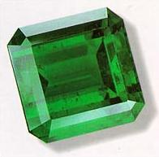
LEVI (Emerald)
Jacob prophecy: “Shimʽon and Lĕwi are brothers, their weapons are implements of violence. .. they slew a man in their displeasure, and they lamed an ox in pleasure. “Cursed be their displeasure for it is fierce, and their wrath for it is cruel! I divide them in Yaʽaqoḇ and scatter them in Yisra’ĕl. (Genesis 49:5-8)
Moses blessing: And of Lĕwi he said, “Your Tummim and Your Urim belong to Your kind one, whom You tried at Massah, with whom You contended at the waters of Meriḇah, who said of his father and mother, ‘I have not seen them.’ And he did not acknowledge his brothers, or know his own children, for they have guarded Your Word and watched over Your covenant. “They teach Your right-rulings to Yaʽaqoḇ, and Your Torah to Yisra’ĕl. They put incense before You, and a complete burnt offering on Your altar. “O יהוה, bless his strength, and accept the work of his hands. Smite the loins of those who rise against him, and of those who hate him, that they rise no more.” (Deuteronomy 33:8-11)
Name meaning: “Attached, joined, united, knotted”
Stone meaning: Beraket, root is “barag” to give light

Slide 19
SHINE LIGHT
The Levites, who are the set-apart priests and teachers, are given a blessing focused on their ability to provide spiritual leadership. The tribe of Levi would be scattered among the various tribes in order to serve as teachers throughout the country. To help them with decisions they had the Thummim and the Urim. Two stones placed in a little pouch in the folded breastplate. Used by the high priest to guide the Israelites. On the stones where inscribed the name of יהוה.
Symbolism: To guide is to shine a light on a situation. The Levites were teachers of the Word, the light bearers in the Old Testament
The tribe of Simeon means “purity” and Levi “to give light”. Totally opposite of their actions and because of this they are cursed and scattered throughout the other tribes because of their anger problems. The two are knitted together in disobedience and darkness.
The opening up of Your words gives light, Giving understanding to the simple. (Psalms 119:130)
For the command is a lamp, And the Torah a light, And reproofs of discipline a way of life, (Proverbs 6:23)

Slide 20
PROTECTING THEIR WALK
who said of his father and mother, ‘I have not seen them.’ And he did not acknowledge his brothers, or know his own children, for they have guarded Your Word and watched over Your covenant. (Deuteronomy 33:9)
יהושע seems to be addressing this kind of loyalty in the book of Luke:
And large crowds were going with Him, and turning, He said to them, “If anyone comes to Me and does not hate his father and mother, and wife, and children, and brothers, and sisters, and his own life too, he is unable to be My taught one. (Luke 14:25-26)
“Hate” is an intense word and probably makes you squirm a bit, but its meaning is different than our usual interpretation. It is used in this verse in a comparative sense, where your loyalty to יהושע should make everything else pale in comparison. If your parents, wife, or children insist that you have nothing to do with your Master, then you must disregard their wishes (not them). It is not an excuse for walking away from family responsibilities, but rather remaining faithful to the One who has called you.

Slide 21
NEW TESTAMENT BLESSING
“You are the light of the world. It is impossible for a city to be hidden on a mountain. (Matthew 5:14)
Therefore יהושע spoke to them again, saying, “I am the light of the world. He who follows Me shall by no means walk in darkness, but possess the light of life.” (John 8:12)
Like the menorah in the Tabernacle we are the light of the World through the spirit of God the Rauch haKodesh that now resides in us.
“Let your light so shine before men, so that they see your good works and praise your Father who is in the heavens. (Matthew 5:16)

Slide 22
LIVING IN THE LIGHT
“For Elohim did not send His Son into the world to judge the world, but that the world through Him might be saved. “He who believes in Him is not judged, but he who does not believe is judged already, because he has not believed in the Name of the only brought-forth Son of Elohim. “And this is the judgment, that the light has come into the world, and men loved the darkness rather than the light, for their works were wicked. “For everyone who is practising evil matters hates the light and does not come to the light, lest his works should be exposed. “But the one doing the truth comes to the light, so that his works are clearly seen, that they have been wrought in Elohim.”
(John 3:17-21)

Slide 23
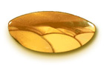
BENJAMIN (Jasper)
Jacob prophecy:
“Binyamin is a wolf that tears, in the morning he eats prey, and at night he divides the spoil.” (Genesis 49:27)
Moses blessing:
Of Binyamin he said, “Let the beloved of יהוה dwell in safety by Him, shielding him all the day, as he dwells between His shoulders.” (Deuteronomy 33:12)
Name meaning: son of my right hand
Stone meaning: “yashfeh” the root is yashefah which is יהוה is our strength
Benjamin was the only one of the 12 who was actually born in the land of Israel. The Temple in Jerusalem would later be located in Benjamin’s territory.

Slide 24
SHARING THE SPOIL
The symbol for the tribe of Benjamin was a wolf. It is believed this was given after what happened to Rachel at his birth. That actually her uterus or womb was torn, and she actually bled to death in giving birth. Rachel was literally torn apart like a wolf tearing flesh whilst eating. Symbolic meaning: When he is young he only cares about himself, and when he is older and more mature he become the elder and shares his prey and helps kill the prey.
He would see the result of the suffering of His life and be satisfied. Through His knowledge My righteous Servant makes many righteous, and He bears their crookednesses. Therefore I give Him a portion among the great, and He divides the spoil with the strong, because He poured out His being unto death, and He was counted with the transgressors, and He bore the sin of many, and made intercession for the transgressors. (Isaiah 53:11-12)
When the Messiah comes back He is going to divide the spoil of His inheritance with His followers, over comers. For we are coming back to rule and reign with Him we aren't just going to sit in heaven all day.

Slide 25
SONS OF MY RIGHT HAND
...Raḥĕl began to give birth, and had great difficulty giving birth. And it came to be, as she was having great difficulty giving birth, that the midwife said to her, “Do not fear, for it is another son for you.” And it came to be, as her life was going out – for she died – that she called his name Ben-Oni. But his father called him Binyamin. (Genesis 35:16-18)
Every son and every stone was always named by the mother, this is the first son that the Jacob names. Benjamin is a type of Messiah seated on the right hand of the Father. It was also the only son to born after Jacob was given the name Israel – “he who rules as יהוה rules”.
Ben-Oni:
Ben means: son or a builder of a household, or family.
Oni means: to exert one’s self in vain, to come to naught, or affliction, evil, or even false idol.
Benjamin
Yamin means: the right hand, right side, right leg, or right eye.
We are can also see that Jacob could be referring to the son of Rachel, his right hand, his wife.

Slide 26
WARRIORS
“Your right hand, O יהוה, has become great in power. Your right hand, O יהוה, has crushed the enemy. (Exodus 15:6)
It is the right hand of יהוה that crushes the enemy as it did pharaoh and his armies and cast them into the sea. The right hand is a symbol of the first born blessing, which is the double portion.
If, then, you were raised with Messiah, seek the matters which are above, where Messiah is, seated at the right hand of Elohim. Mind the matters above, not those on the earth. For you have died, and your life has been hidden with Messiah in Elohim. (Colossians 3:1-3)
If we look in 1 Chronicles 12:16, 18 and 29 we see that the tribe of Benjamin was one of the first one to gather themselves with David. The had some left handed archers who never missed the mark. It almost ironic that a tribe whose name means son of my right hand where left handed and they never missed the mark. Another word for sin – missing the mark.

Slide 27
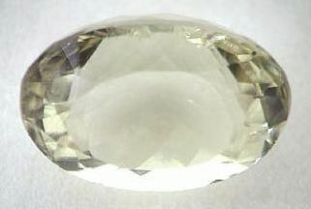
JOSEPH (Onyx)
Name meaning: יהוה has added to me another son
Stone meaning: “Shocham” the root is cham which is zeal, or jealousy. Another translation - he will collect or gather
Moses blessing: And of Yosĕph he said, “Blessed of יהוה is his land, with the choicest from the heavens, with the dew, and the deep lying beneath, with the choice fruits of the sun, with the choice yield of the months, with the finest of the ancient mountains, with the choicest of the everlasting hills, with the choicest of the earth and all that fills it, and the good pleasure of Him who dwelt in the bush. Let it come on the head of Yosĕph, and on the crown of the head of him who was separate from his brothers. “His splendour is like a first-born bull, and his horns are like the horns of the wild ox. With them he pushes the peoples to the ends of the earth. And they are the ten thousands of Ephrayim, and they are the thousands of Menashsheh.”
(Deuteronomy 33:13-17)

Slide 28
THE VINE
Jacob Prophecy: “Yosĕph is an offshoot of a fruit-bearing tree, an offshoot of a fruit-bearing tree by a fountain, his branches run over a wall. “And the archers have bitterly grieved him, shot at him and hated him. “But his bow remained in strength, and the arms of his hands were made strong by the hands of the Mighty One of Yaʽaqoḇ – from there is the Shepherd, the Stone of Yisra’ĕl – from the Ěl of your father who helps you, and by the Almighty who blesses you with blessings of the heavens above, blessings of the deep that lies beneath, blessings of the breasts and of the womb. “The blessings of your father have excelled the blessings of my ancestors, up to the limit of the everlasting hills. They are on the head of Yosĕph, and on the crown of the head of him who was separated from his brothers. (Genesis 49:22-26)
.“Joseph is a fruitful vine” – יהושע the vine - John 15:1 "I am the true vine, and my Father is the gardener.

Slide 29
SEPERATED
“Let all these rest on the head of Joseph, on the brow of the prince among his brothers.”
Joseph is separated from his brothers through his position. The Hebrew word is “Nazyir” – one who is set apart, or holy, completely to יהוה a Nazarite.
יהושע : And so יהושע also suffered outside the gate, to set apart the people with His own blood. (Hebrews 13:12)
Us: But when it pleased Elohim, who separated me from my mother’s womb and called me by His favour, (Galatians 1:15)
I call upon you, therefore, brothers, through the compassion of Elohim, to present your bodies a living offering – set-apart, well-pleasing to Elohim – your reasonable worship. (Romans 12:1)

Slide 30
ZEALOUS
Truly brothers, my heart’s desire and prayer to Elohim for Yisra’ĕl is for deliverance. For I bear them witness that they have an ardour for Elohim, but not according to knowledge. For not knowing the righteousness of Elohim, and seeking to establish their own righteousness, they did not subject themselves to the righteousness of Elohim. (Romans 10:1-3)
And when they heard it, they praised the Master. And they said to him, “You see, brother, how many thousands of Yehuḏim there are who have believed, and all are ardent for the Torah. (Acts 21:20)
“I advise you to buy from Me gold refined in the fire, so that you become rich; and white garments, so that you become dressed, so that the shame of your nakedness might not be shown; and anoint your eyes with ointment, so that you see. “As many as I love, I reprove and discipline. So be ardent and repent. “See, I stand at the door and knock. If anyone hears My voice and opens the door, I shall come in to him and dine with him, and he with Me. (Revelation 3:18-20)

Slide 31
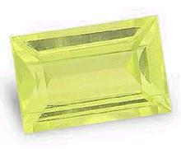
ZEBULUN (Beryl)
Jacobs prophecy: “Zeḇulun dwells at the seashore, he is for a haven for ships, and his border is unto Tsiḏon. (Genesis 49:13)
Moses blessing: And of Zeḇulun he said, “Rejoice, O Zeḇulun, in your going out, and Yissasḵar in your tents! “They call peoples to the mountain, there they bring offerings of righteousness, for they draw from the riches of the seas, and treasures hidden in the sand.” (Deuteronomy 33:18-19)
Name meaning: means to dwell
Stone meaning: “tarshish” roots of this word “tarash” meaning to reverence
The symbol of Zebulun is ships: Seas are symbolic of a lot of people, the word haven is “choph” Sidon in Hebrew means to “catch fish” or fisherman. So Zebulun like to fish for men, that is why they love to be in seas of people.
And יהושע said to them, “Come, follow Me, and I shall make you become fishers of men.” (Mark 1:17)

Slide 32
SCRIBE
“Out of Ephrayim their root is against Amalĕq. After you, Binyamin, with your peoples, out of Maḵir lawgivers came down, and out of Zeḇulun those who handle the scribe’s reed. (Judges 5:14)
“Shebet” – in the Hebrew; to branch off, a stick used for punishing, writing, fighting ruling, walking, correction, a rod, a sceptre, a staff, or a staff of a tribe.
In Hebrew writer is “saphar” – to tally, to record, to speak , to tell, a writer.
So we find out that Zebulun is one who knows the Word of יהוה. We know that the Word is used for doctrine, correction, admonition, for edification; all these definition describe the scribes pen exactly for the Word of יהוה.

Slide 33
REVERENCE
Looking at the stone one of the attribute we are going to have to possess if we are to become יהוה Shammah and to enter into יהוה Shammah is to reverence God.
He sent redemption to His people, He has commanded His covenant forever. Set-apart and awesome is His Name. The fear of יהוה is the beginning of wisdom, All those doing them have a good understanding. His praise is standing forever.
(Psalms 111:9-10)
Holy (Reverend KJV) yârê‘ - A primitive root; to fear; morally to revere; causatively to frighten: be (make) afraid, dread (-ful), (put in) fear. (be had in) reverence (-end), X see, terrible (act, -ness, thing).

Slide 34
REVERE HIS NAME
He sent redemption to His people, He has commanded His covenant forever. Set-apart and awesome is His Name. (Psalms 111:9)
The most critical people are those that go to a church where the Pastor takes on the title or reverend, rabbi or father. Scripture is very clear there is one name that is to be revered.
יהוה’s name is to feared
יהוה’s name is to be dreaded
יהוה’s name is to be frightened of
We treat the set apart things of יהוה as though they are profane. The way we treat the Word of God, the things of God etc, we have no respect.
So that, my beloved, as you always obeyed – not only in my presence, but now much rather in my absence – work out your own deliverance with fear and trembling, (Philippians 2:12)

Slide 35
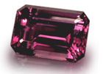
ISSACHAR (Amethyst)
Jacobs Prophecy: “Yissasḵar is a strong donkey lying down between two burdens, and he saw that a resting place was good, and that the land was pleasant, and he inclined his shoulder to bear a burden, and became a subject to slave labour. (Genesis 49:14-15)
Name meaning: means will bring a reward
Stone meaning: “Achlamah” roots of this word “challam” meaning to join closely
The term forced labour comes from the word “Abad” meaning: to work, to serve, to keep in bondage, a bondservant, to compel, to labour. Issachar was willing to become a bond servant to work for the rest of His life as a servant to his master and never leave the master’s house.
Yet he finds rest on the Sabbath he lays down his burdens and worships Yahweh and he find the resting place good.

Slide 36
BLESSING
And of Zeḇulun he said, “Rejoice, O Zeḇulun, in your going out, and Yissasḵar in your tents! “They call peoples to the mountain, there they bring offerings of righteousness, for they draw from the riches of the seas, and treasures hidden in the sand.”
(Deuteronomy 33:18-19)
They have the ability to bring the best out of people, the riches out of people, out of the seas. In order to understand this characteristic we need to look at marriage. We have to understand that יהוה wants a family, that is why we where created. יהוה wants a family that will raise righteous seed unto Himself. If we understand the relationship that he wants with Israel then you will understand the relationship that he wants us to have with Him: that is the one of marriage.

Slide 37
SABBATH AND BURDENS
…‘Thus said יהוה, “Guard yourselves, and bear no burden on the Sabbath day, nor bring it in by the gates of Yerushalayim, nor take a burden out of your houses on the Sabbath day, nor do any work. And you shall set apart the Sabbath day, as I commanded your fathers. “But they did not obey, or incline their ear, and they made their neck stiff not to hear and not to receive instruction. “And it shall be, if you diligently obey Me,” declares יהוה, “to bring in no burden through the gates of this city on the Sabbath day, and set apart the Sabbath day, to do no work in it, then sovereigns and heads sitting on the throne of Dawiḏ shall enter in through the gates of this city, riding in chariots and on horses, they and their heads ...they shall come from the cities of Yehuḏah and from the places around Yerushalayim, and from the land of Binyamin and from the low country, from the mountains and from the South, bringing burnt offerings and slaughterings, grain offerings and incense, bringing offerings of praise to the House of יהוה. “But if you do not obey Me to set apart the Sabbath day, and not to bear a burden when entering the gates of Yerushalayim on the Sabbath day, then I shall kindle a fire in its gates, and it shall consume the palaces of Yerushalayim, and not be quenched.” ’ ”(Jeremiah 17:20-27)

Slide 38
TO YOKE TOGETHER
and said, ‘For this cause a man shall leave his father and mother and cleave to his wife, and the two shall become one flesh’? “So that they are no longer two, but one flesh. Therefore, what Elohim has joined together, let man not separate.” (Matthew 19:5-6)
The Greek word for cleaving is “Suzeagnumi” meaning: joined together, joined in marriage, a yoke together, two people in a yoke.
And I appeal to you, brothers, by the Name of our Master יהושע Messiah, that you all agree, and that there be no divisions among you, but that you be knit together in the same mind and in the same opinion. (1 Corinthians 1:10)
The word united means to be joined or mended “kartartizo” to complete thoroughly, thus we must be joined in the same opinion.

Slide 39
BECOME ONE
... and they shall become one flesh. (Genesis 2:24)
Becoming one “echad” united, become alike, alone, they become one, they become only, the become together.
Cleave “debak” means to cling, to adhere, to abide, to cleave fast together, to stick, to be joined together, to join closely. So to be married is to become is to cleave together to become one and that is the significance of the stone “join closely”
“And I do not pray for these alone, but also for those believing in Me through their word, so that they all might be one, as You, Father, are in Me, and I in You, so that they too might be one in Us, so that the world might believe that You have sent Me. “And the esteem which You gave Me I have given them, so that they might be one as We are one, “I in them, and You in Me, so that they might be perfected into one, so that the world knows that You have sent Me, and have loved them as You have loved Me. (John 17:20-23)

Slide 40
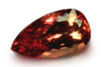
GAD (Jacinth)
Jacob prophecy: “Gaḏ, a raiding band raids him, but he raids its heel.
(Genesis 49:19) So we have troop versus a troop, or another meaning Gad was His own worst enemy attacking himself. Sometime we are our own worst enemies
Moses blessing: And of Gaḏ he said, “Blessed is he who enlarges Gaḏ. He dwells as a lion, and shall tear off the arm, also the crown. “And he chose the best for himself, for there the portion of the lawgiver was hidden. And he came with the heads of the people. The righteousness of יהוה he did, and His right-rulings with Yisra’ĕl.” (Deuteronomy 33:20-21)
There is a blessing for those who help enlarge Gad, there is a blessing in store who help spread the message of the Good news of יהושע.
Name meaning: Gad means troop, fortune, invade or attack
Stone meaning: “leshem” roots of this word meaning shem or name

Slide 41
BABYLONIAN GAD
“But you are those who forsake יהוה, who forget My set-apart mountain, who prepare a table for Gad, and who fill a drink offering for Meni. (Isaiah 65:11)
Meaning: gâd, gawd, From H1464 fortune: - troop.
Gawd/God - the common tectonic (pertaining to construction or architecture) word for a personal object of religious worship, and applies to all those super human beings in the heathen mythologies in Encyclopaedia Britannica. Webster “ the word is common to tectonic tongues and it was applied to heathen deities, and later when the tectonic peoples where converted to Christianity, the word was elevated to the Christian sense
If translated incorrectly translators could use the name of Gawd/God for the name of Yahweh.

Slide 42
SHIELD AND SWORD
And some Gaḏites separated themselves to Dawiḏ at the stronghold in the wilderness, mighty brave men, men trained for battle, who could handle shield and spear, whose faces were like the faces of lions, and were as swift as gazelles on the mountains: (1 Chronicles 12:8)
Gad also walks around like a mature seasoned lion – “Lebaot”. The tribe of gad is also fierce warriors and go directly for the crown.
above all, having taken up the shield of belief with which you shall have power to quench all the burning arrows of the wicked one. Take also the helmet of deliverance, and the sword of the Spirit, which is the Word of Elohim. (Ephesians 6:16-17)
The Gadites have great faith, and are always fighting in the spirit. Mostly intercessors around you, that are fierce in spiritual combat and battle.

Slide 43
ONLY REASON FOR DEATH
יהושע said to him, “You have said it. Besides I say to you, from now you shall see the Son of Aḏam sitting at the right hand of the Power, and coming on the clouds of the heaven.” Then the high priest tore his garments, saying, “He has blasphemed! Why do we need any more witnesses? See, now you have heard His blasphemy!
(Matthew 26:64-65)
Some bibles say the “almighty one”. Matthew could not use the real name יהושע used to described God because it was under a ban. It is that exact ban that God יהושע crucified. From the oral tradition the only way a person could be put to death on the charge of blasphemy was if he uttered the Tetragramaton – יהוה. There was no other charge against יהושע.

Slide 44

DAN (Sapphire)
Jacobs prophecy: “Dan rightly rules his people as one of the tribes of Yisra’ĕl. “Dan is a serpent by the way, an adder by the path, that bites the horse’s heels so that its rider falls backward. “I have waited for your deliverance, O יהוה! (Genesis 49:16-18)
Moses blessing: And of Dan he said, “Dan is a lion’s cub, that leaps from Bashan.” (Deuteronomy 33:22)
Name meaning: “dun”, it means to rule, to judge, to strive, to contend with, to execute judgement, to plead a cause, to discern.
Stone meaning: “Saphir” meaning book, the book of יהוה
The above prophecy is a bit of word play from the original curse spoken over satan in the garden of Eden. “And I put enmity between you and the woman, and between your seed and her Seed. He shall crush your head, and you shall crush His heel.” (Genesis 3:15). A tribe that will do the same as satan for different reasons.

Slide 45
SONS OF DAN
Dan married an Edomite a descendant of Esau: Esau was rebellious, did not care about birthright. When the kingdom of Israel split one of the golden calves were placed at Dan.
And these went into Miḵah’s house and took the idol, and the shoulder garment, and the house idols, and the moulded image. Then the priest said to them, “What are you doing?” And they said to him, “Be silent, put your hand over your mouth, and come with us, and be a father and a priest to us. Is it better for you to be a priest to the household of one man, or that you be a priest to a tribe and a clan in Yisra’ĕl?” And the heart of the priest was glad. And he took the shoulder garment, and the house idols, and the carved image, and took his place among the people. (Judges 18:18-20)
And they called the name of the city Dan, after the name of Dan their father, who was born to Yisra’ĕl. But previously the name of the city was Layish. And the children of Dan set up for themselves the carved image. And Yehonathan son of Gĕreshom, son of Menashsheh, and his sons were priests to the tribe of Dan until the day the land was taken into exile. (Judges 18:29-30)

Slide 46
APPROVED BY GOD
“If you do not guard to do all the Words of this Torah that are written in this book, to fear this esteemed and awesome Name, יהוה your Elohim, then יהוה shall bring upon you and your descendants extraordinary plagues, great and lasting plagues, and grievous and lasting sicknesses. “And He shall bring back on you all the diseases of Mitsrayim, of which you were afraid, and they shall cling to you, also every sickness and every plague, which is not written in the book of this Torah, יהוה does bring upon you until you are destroyed. (Deuteronomy 28:58-61)
Do your utmost to present yourself approved to Elohim, a worker who does not need to be ashamed, rightly handling the Word of Truth. (2 Timothy 2:15)
Samson was a Danite used to judge the Philistines.
Used twice to build the fathers house: Exodus 35:34, 2 Chronicles 2:13-14 NIV

Slide 47
JUDGED BY THE WORD
“Do not judge according to appearance, but judge with righteous judgment.” (John 7:24)
“And if anyone hears My Words but does not watch over them, I do not judge him. For I did not come to judge the world but to save the world. “He who rejects Me, and does not receive My Words, has one who judges him: the Word that I have spoken shall judge him in the last day. (John 12:47-48)
What יהושע is saying it will be the very words that He has spoken that will judge us. The word of the torah, prophets and writings. He didn’t have anymore to say as because He wrote the word and he is the Living Torah incarnate. He was showing what Torah looked like when it was lived out by a Man who kept the Torah, who was truly righteous.

Slide 48
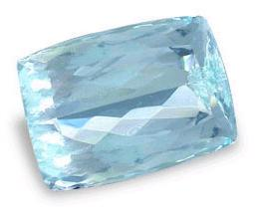
NAPHTALI (Diamond)
Jacobs prophecy:
“Naphtali is a deer let loose, he gives words of elegance. (Genesis 49:21).
Moses blessing:
And of Naphtali he said, “O Naphtali, satisfied with pleasure, and filled with the blessing of יהוה, possess the west and the south.” (Deuteronomy 33:23)
Name meaning: root word “tathal” it means to “you struggle, to wrestling, go forward, to be torturerous, to twine”.
Stone meaning: “yahalom” meaning to heal
The tribe of Naphtali are reckless as a deer, very swift and untamed. God likes the free spirit of the Deer in Naphtali, thus it brings great favour in the eyes of the Lord, but this free spirit must be channelled in the right direction otherwise idolatry will creep in.

Slide 49
DISOBEDIENCE /OBEDIENCE
Neither did Naphtali drive out the inhabitants of Bĕyth Shemesh nor the inhabitants of Bĕyth Anath, but they dwelt among the Kenaʽanites, the inhabitants of the land. And the inhabitants of Bĕyth Shemesh and of Bĕyth Anath became compulsory labour for them. (Judges 1:33)
Because of their free spirit they allowed the people to live and with that still worship the God’s. In the inhabitants are known as the house of the rising sun or sun worshippers.
“But to you who fear My Name the Sun of Righteousness shall arise with healing in His wings. And you shall go out and leap for joy like calves from the stall. (Malachi 4:2)
Once again the opposite is expected from the children of God. And when we receive the healing from יהושע we will leap like young calves in a stall.

Slide 50
GREAT STRUGGLE
And Raḥĕl said, “With great wrestlings I have wrestled with my sister, and I have overcome.” So she called his name Naphtali. (Genesis 30:8)
And Yaʽaqoḇ was left alone. And a Man wrestled with him until the breaking of day. (Genesis 32:24)
Notes:
Naphtali means “my struggle” not your struggle.
The wrestling with Jacob takes place at night, night is symbolic of darkest period in life, a time when all seems hopeless.
When we struggle we are normally alone.
יהוה will place you into a situation where you must wrestle with Him, you must wrestle with yourself, because He is bring change in your life.
for whom יהוה loves, He disciplines, and flogs every son whom He receives.”(Hebrews 12:6)

Slide 51
OUR STRENGTH
And when He saw that He did not overcome him, He touched the socket of his hip. And the socket of Yaʽaqoḇ’s hip was dislocated as He wrestled with him. (Genesis 32:25)
“I have been impaled with Messiah, and I no longer live, but Messiah lives in me. And that which I now live in the flesh I live by belief in the Son of Elohim, who loved me and gave Himself for me. (Galatians 2:20)
Notes:
The femur is one of the strongest bones in the human body. יהוה will touch what you think is your strength, and cause you to be weak.
When we overcome for example: sickness and the ways of the world that hold us captive we will be called over comers, and this temporal situation is nothing compared to inheriting the blessing and promises God has for us.

Slide 52
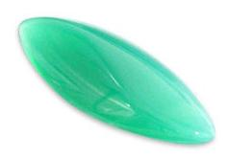
ASHER (Agate)
Jacobs prophecy: “Bread from Ashĕr is rich, and he gives delicacies of a sovereign. (Genesis 49:20)
Moses blessing: And of Ashĕr he said, “Ashĕr is most blessed of sons. Let him be accepted by his brothers, and dip his foot in oil. “Your sandals are iron and bronze, and your strength as your days. (Deuteronomy 33:24-25)
Name meaning: “Asher” means joyful
Stone meaning: “Shevo” roots of this word meaning “shuv “– means to restore to life, to turn back, and to return
The Hebrew word for bread is “Lechem” and it means food, grain, fruit, meat. It means any type of food. The word fat is “shamen” greasy plenteous rich, the root word is oily , to shine or richly anointed. The symbol of the tribe of Asher, is the Olive tree, the symbol of Israel
Asher is going to dip his foot into oil, oil is a symbol of Rauch ha Kodesh (Holy Spirit). Iron and bronze are a symbol of judgement in other words Asher would bring judgement on others because of his walk with the Holy Spirit.

Slide 53
TURN BACK
and having fitted your feet with the preparation of the Good News of peace; (Ephesians 6:15)
When we are fitted to go fort and proclaim the gospel we have a walk of judgement , but it is a anointed walk. (We will always be judged according to what we say and do).
But first we have to turn back
From that time יהושע began to proclaim and to say, “Repent, for the reign of the heavens has drawn near.” (Matthew 4:17)
A primitive root of “Shuva” to turn back, to repent from old ways “Teshuvah” repentance. I am sorry is not true repentance but rather to turn away from old ways.
But those who turn aside to their crooked ways, יהוה shall lead them away With the workers of wickedness. Peace be upon Yisra’ĕl! (Psalms 125:5)

Slide 54
WARFARE
Neither did Ashĕr drive out the inhabitants of Akko nor the inhabitants of Tsiḏon, nor of Aḥlaḇ, nor of Aḵziḇ, nor of Ḥelbah, nor of Aphiq, nor of Reḥoḇ. (Judges 1:31) Judges 5:17-18
They don’t like conflict and would rather stay in a safe haven. They would rather take on the ways of the others and their God’s before they enter into conflict for the will of God.
Where it was their weakness it also became their strength.
All these were the children of Ashĕr, heads of their fathers’ houses, chosen ones, mighty brave men, chief leaders. And when they registered by genealogy for the army, for battle, their number was twenty-six thousand. (1 Chronicles 7:40)

Slide 55
THE FATHER RUNS
“And do not be like your fathers and like your brothers, who trespassed against יהוה Elohim of their fathers, so that He gave them up to ruin, as you see. “Now do not stiffen your neck, like your fathers, stretch forth the hand to יהוה, and come to His set-apart place, which He has set apart forever, and serve יהוה your Elohim, so that His burning wrath turns away from you. (2 Chronicles 30:7-8)
‘Come, and let us turn back to יהוה. For He has torn but He does heal us, He has stricken but He binds us up. (Hosea 6:1)
The father will meet you:
“And having risen, he went to his father. And while he was still a long way off, his father saw him and was moved with compassion, and ran and fell on his neck and kissed him. (Luke 15:20)
When we turn to the Father, He does not meet us halfway He does most of the work, He runs towards you because you have accepted the way He has made for you.

Slide 56
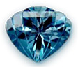
SIMEON (Topaz)
We note one tribe is absent from Moses' blessings namely Simeon. For this we need to take a look at Jacob’s negative deathbed blessing over his sons Simeon and Levi to define why.
Jacobs prophecy: “Shimʽon and Lĕwi are brothers, their weapons are implements of violence. “Let my being not enter their council, let my esteem not be united to their assembly; because they slew a man in their displeasure, and they lamed an ox in pleasure. “Cursed be their displeasure for it is fierce, and their wrath for it is cruel! I divide them in Yaʽaqoḇ and scatter them in Yisra’ĕl. (Genesis 49:5-7)
Name meaning: “hears and obey” Genesis 29:33
Stone meaning: Pitdah, root is “phatad” to be pure
One of the problems of the Old Covenant as that it was impossible for anybody to live pure. In Genesis 34 Simeon and Levi killed the person who raped Dinah their sister including their entire family after Abraham had already made arrangements for restitution. Un-forgiveness and hard heart the opposite of purity.

Slide 57
HISTORY OF SIMEON
Simeon and Levi are both the recipients of what reads as more of a curse than a blessing, but Levi, redeemed himself after the golden calf incident. Both tribes were “scattered” in Israel as verse 6 indicates.
But the tribe of Simeon, however, continued to make mistakes. They suffered as a result of one of their leaders who took a Midianite woman into the tabernacle to have sex with her (Numbers 25:6-14). A resultant plague killed many from their tribe as indicated by a census in Numbers 26. As we follow Simeon through the Scriptures, they will end up with a circle of territory completely surrounded by Judah. Eventually they were absorbed by Judah and pretty much vanished as an identifiable tribe.

Slide 58
THOMAS BRADFORD part 1
Here is what I find interesting: we have Moses last words in Deuteronomy 33 as spoken to the 12 tribes, but one of the tribes (Simeon) had been cursed and so is left out, leaving 11 tribes. It has always been noticed that just as there were 12 original tribes of Israel, there were the 12 original disciples of Yeshua. One of these disciples was an infamous man named Judas Iscariot. There is some argument over what “Iscariot” means; some say it is referring to a geographical region called K’riot. Others say it is a play on the word “Sicarri”. Recall that Judas was a fundamentalist militant who was trying to foment another Jewish rebellion against its oppressor, Rome. Judas’ actions show just how radical he was in turning in Yeshua when he decided that Yeshua was not going to be the Saviour of Israel Judas had hoped for, because Jesus simply was not a military leader with insurrection on His mind. Judas was a Zealot; Zealot was the name of a Jewish political party. They might be compared with Zionists today; people who feel that only Jews should occupy and/or govern the Holy Lands. One faction of the Zealot party was called the Sicarri; these men were out and out assassins who tried to enforce their brand of Judaism and patriotism on everyone else by intimidation….

Slide 59
THOMAS BRADFORD part 2
Where did Judas come from, and who was his family? Most of the other disciples were Galileans, but not much is known about Judas; yet we do find a very tantalizing piece of information in John 13:26. Yeshua answered, “It’s the one to whom I give this piece of matzah after I dip it in the dish.” So he dipped the piece of matzah and gave it to Y’hudah Ben-Shim’on (Judas son of Simeon) from K’riot.
What makes this tantalizing is that we find that Judas is the son of Simon, or as here in the CJB, Shim’on. Here’s the thing: Simon, Shim’on, and Simeon (as in the tribe of Simeon) are all the same Hebrew name, just transliterated into variant English spellings. It was the norm in the Bible era to identify a person by his tribe, so a Hebrew with the family name of Shim’on was usually attached by heritage to the tribe of Shim’on, Simeon. You wouldn’t, for example, name a person Levi if they were of the tribe of Ephraim, or Manasseh if they were from Dan.
So almost certainly Judas was from the tribe of Simeon, long ago absorbed into the Judah tribe, but still remembering its family heritage by use of the family name Simeon.

Slide 60
THOMAS BRADFORD part 3
Moses was giving his final words to the 12 tribes only hours before his death. And in his final words (that amounts to a series of individual prophetic blessings) Moses mysteriously leaves out Simeon who had been given a cursed prophetic future by Jacob. So the blessing of Moses was only upon 11 of the 12 tribes. We fast-forward 13 centuries to the time of Yeshua. The night before He is to die, Yeshua is giving His final words to His disciples, by means of offering blessings at the Passover table. All 12 disciples are there, but one, Judas, disappears and fetches the Temple Guard who arrests Yeshua and turns him over to the Romans to be tried and killed. Judas who is from the tribe of Simeon (as his family name implies) is cursed by his act then commits suicide, and now there are 11 disciples.
Knowing the power of patterns, the blessing of Moses over the 12 tribes carried forward into the blessings of Yeshua over the 12 disciples. The circumstances are eerily familiar, the fact that Moses and Yeshua were both blessing 12 is the same, that it was immediately before their deaths that is the same, that one of the 12 was removed is the same, and that the one who was removed is associated with the Simeon tribe, the cursed tribe is the same.”

Slide 61
REALITY (TODAY)
So then, beloved ones, looking forward to this, do your utmost to be found by Him in peace, spotless and blameless, (2 Peter 3:14)
And everyone having this expectation in Him cleanses himself, as He is clean. (1 John 3:3)
We are instructed to live at our best in purity and peace an glistening example of the life יהושע portrayed while on earth.
Become, then, imitators of Elohim as beloved children. And walk in love, as Messiah also has loved us, and gave Himself for us, a gift and an offering to Elohim for a sweet-smelling fragrance. But whoring and all uncleanness, or greed of gain, let it not even be named among you, as is proper among set-apart ones – neither filthiness, nor foolish talking, nor coarse jesting, which are not fitting, but rather thanksgiving. For this you know, that no one who whores, nor unclean one, nor one greedy of gain, who is an idolater, has any inheritance in the reign of Messiah and Elohim. (Ephesians 5:1-5)

Slide 62
QUALITIES OF THE 12 TRIBES
Reuben – Submission to יהוה
Simeon – To be pure
Levi – To give light
Judah – Instruction of יהוה
Dan – Book of יהוה
Naphtali – To heal
Zebulun – To reverence יהוה
Joseph – Zeal for יהוה
Benjamin – יהוה our strength
Gad – יהוה name and authority
Asher – To restore to life, return to יהוה
Issachar – To join closely

Slide 63
12 FOUNDATION STONES
And the foundations of the wall of the city were adorned with all kinds of precious stones: the first foundation jasper, the second sapphire, the third agate, the fourth emerald, the fifth sardonyx, the sixth ruby, the seventh chrysolite, the eighth beryl, the ninth topaz, the tenth chrysoprase, the eleventh jacinth, and the twelfth amethyst.
(Revelation 21:19-20)

Slide 64
CORRUPTED QUALITIES
Reuben - Ruby – Submission to Rebellion
Simeon - Topaz – To be pure to unclean
Levi - Emerald –To give light to darkness or ignorance
Judah - Turquoise – Instruction of יהוה to no law
Dan - Sapphire – Book of יהוה to half truth
Naphtali - Diamond – To heal to sickness and disease
Zebulun - Beryl – To reverence יהוה to irreverence,
profane, make common
Joseph - Shoham – Zeal for יהוה to lukewarmness,
indifference
Benjamin - Jasper – יהוה our strength to trying to rely on
your own flesh, your own strength to
get things accomplished

Slide 65
SATAN’S BREASTPLATE
“Son of man, take up a lamentation for the sovereign of Tsor, and you shall say to him, ‘Thus said the Master יהוה, “You were sealing up a pattern, complete in wisdom and perfect in loveliness. “You were in Ěḏen, the garden of Elohim. Every precious stone was your covering: the ruby, topaz, and diamond, beryl, shoham, and jasper, sapphire, turquoise, and emerald and gold. The workmanship of your settings and mountings was prepared for you on the day you were created. “You were the anointed keruḇ that covered. And I placed you, you were on the set-apart mountain of Elohim. You walked up and down in the midst of stones of fire. “You were perfect in your ways from the day you were created, until unrighteousness was found in you.
(Ezekiel 28:12-15)
Satan had 9 of the 12 stones as studied in יהוה Shammah

Slide 66
MISSING CHARACTERISTICS
Jacinth – The name of יהוה
Satan lost the right to the Name of יהוה and all the authority that goes with it.
Agate – to restore to life, to return to יהוה
Satan has lost the right to repent
Amethyst – to join closely
Satan has no right to covenants or blessings

Slide 67
BANISHMENT AND RESTORATION
“The Elohim of old is a refuge, and beneath are everlasting arms. And He drives out the enemy from before you and says, ‘Destroy!’ “Thus Yisra’ĕl dwells in safety, the fountain of Yaʽaqoḇ alone, in a land of grain and new wine. His heavens also drop down dew. (Deuteronomy 33:27-28)
Jewish commentator Mordekhai Sabato points out two words in Deuteronomy 33:27-28 which detail the expulsion of the enemy and Israel’s return to reside in the land:
ויגרשׁ - He will cast out out
ויאמר - He shall dwell
and He drove the man out. And He placed keruḇim at the east of the garden of Ěḏen, and a flaming sword which turned every way, to guard the way to the tree of life. (Genesis 3:24)
This is not coincidental, the Torah is making an association between the banishment of Adam from the Garden (beginning of the Torah) and Israel returning to the land to settle (end of the Torah). Thus we see the Almighty’s plan for restoring mankind after his exile.

Slide 68
RESTORATION AND BANISHMENT
We see the patterns described in Deuteronomy 33:27-28 and Genesis 3:24 reoccurring in Revelation. We see our Deliverer using that sword that protected the garden, to cast out the enemy:
And I saw the heaven opened, and there was a white horse. And He who sat on him was called Trustworthy and True, and in righteousness He judges and fights... and having been dressed in a robe dipped in blood – and His Name is called: The Word of יהוה. And the armies in the heaven, dressed in fine linen, white and clean, followed Him on white horses. And out of His mouth goes a sharp sword, that with it He should smite the nations. ..(Revelation 19:11-15)
Isaiah mentions the transformation back to an Eden-like existence:
“For יהוה shall comfort Tsiyon, He shall comfort all her waste places. For He makes her wilderness like Ěḏen, and her desert like the garden of יהוה. Joy and gladness are found in it, thanksgiving and the voice of song. (Isaiah 51:3)

Slide 69
THE LAND
Jeremiah gives us a picture of what it will be like when the tribes return to the land. Compare some of the words with Deuteronomy 33:28:
“For יהוה shall ransom Yaʽaqoḇ, and redeem him from the hand of one stronger than he. “And they shall come in and shall sing on the height of Tsiyon, and stream to the goodness of יהוה, for grain and for new wine and for oil, and for the young of the flock and the herd. And their being shall be like a well-watered garden, and never languish again. “Then shall a maiden rejoice in a dance, and young men and old, together. And I shall turn their mourning to joy, and shall comfort them, and shall make them rejoice from their sorrow, and shall fill the being of the priests with fatness. And My people shall be satisfied with My goodness,” declares יהוה. (Jeremiah 31:11-14)

Slide 70
1000 YEAR MILLENNIUM
After the 1,000 year millennium, we see the final transformation. The Tree of Life from the Garden of Eden once more enters into the picture.
And he showed me a river of water of life, clear as crystal, coming from the throne of Elohim and of the Lamb. In the middle of its street, and on either side of the river, was the tree of life, which bore twelve fruits, each tree yielding its fruit every month. And the leaves of the tree were for the healing of the nations. And no longer shall there be any curse, and the throne of Elohim and of the Lamb shall be in it, and His servants shall serve Him. (Revelation 22:1-3)

Slide 71
THE LAST DAY
And Mosheh went up from the desert plains of Mo’aḇ to Mount Neḇo, to the top of Pisgah, which is opposite Yeriḥo. And יהוה showed him all the land of Gilʽaḏ as far as Dan, and all Naphtali and the land of Ephrayim and Menashsheh, all the land of Yehuḏah as far as the Western Sea, (Deuteronomy 34:1-2)
Moses saw a panorama of Israel’s future territory from Mount Nebo. Some parts of the land are not viewable from this mountain. The verse actually tells us that יהוה showed him, thereby giving him a perspective that otherwise would have been impossible. So since יהוה was giving him eyes to see, which can also imply a spiritual vision, what else might Moses have actually perceived?
There is a phrase in Deuteronomy 34:2: “the western sea” that can also be interpreted – the last day (Nehemiah 8:18). Insert that interpretation back into the verse and you see that יהוה showed him all the land….as far as the last day.

Slide 72
SERVANT OF יהוה
And Mosheh the servant of יהוה died there in the land of Mo’aḇ, according to the mouth of יהוה. (Deuteronomy 34:5)
It is no surprise to us that Moses is called the “servant of יהוה”. Yet this is the very first time in the Torah that he is given this title. The word for servant literally means “slave”. Moses was designated to be the property of His Master with no identity of his own. He lived his life devoted to the one he loved. It was most likely Joshua (יהושע type) who penned these final words of the Torah. It was the highest possible compliment that could have been paid to Moses to call him a servant of יהוה. The same words were said about יהושע :
who, being in the form of Elohim, did not regard equality with Elohim a matter to be grasped, but emptied Himself, taking the form of a servant, and came to be in the likeness of men. And having been found in fashion as a man, He humbled Himself and became obedient unto death, death even of a stake. (Philippians 2:6-8)

Slide 73
MOSE WAS NOT SICK
And Mosheh was one hundred and twenty years old when he died. His eyes were not dim nor his freshness gone. (Deuteronomy 34:7)
Moses was not sick or weak when he died. Yet it was part of the plan that Moses would have to die before Israel could enter the Promised Land.
“יהוה your Elohim shall raise up for you a Prophet like me from your midst, from your brothers. Listen to Him, (Deuteronomy 18:15)
This Prophet, who is our Adonai and Messiah יהושע, also had to suffer death before His people would be able to enter the Promised Land and claim the promises. The same applies to us before we can enter the promised land.
“I have been impaled with Messiah, and I no longer live, but Messiah lives in me. And that which I now live in the flesh I live by belief in the Son of Elohim, who loved me and gave Himself for me. (Galatians 2:20)

Slide 74
SUMMARY
The first letter of the Torah is a:
ב (bet)
It is a picture of a “house”. The last word of the Torah is
ישׂראל (Israel)
A house is a Hebraic picture of a family. Israel is that bride chosen to dwell in His house. That is the story of Torah.
The first and last letters of the Torah
ב ל (lev)
That means heart. Torah is the revelation of the heart of the Father. And for some unknown reason, He has chosen us to dwell in His House. Our own hearts need to respond to that undeserved and incredible gift of love!

